Slide 1
Notes:
Introduction
This resource package accompanies the You Can Make It! book.
Lesson timing is flexible and can fit a one-hour [PART ONE] or two-hour lesson block [PART ONE + PART TWO].
Within each one-hour block, depending on the cohort, they can be set up to complete either one or two grid activities to support the explicit teaching points.
Lesson structure is modelled on Jane Pollock’s GANAG model of lesson planning and delivery. A goal is set at the beginning of the session and students are asked to rate their understanding at the start and end of the session.
There are many ways to do this; you can use an existing self-assessment tool you have already established in the classroom, such as thumbs up/thumbs down, or faces showing different emotions.
One method is to have the numbers one to four on paper on the walls in different corners of the classroom, and to then write the goal on a personal whiteboard, and for students to move to the number that they feel represents their understanding
(1 - I have no idea what this means; 2 – I understand half or less of what this is about; 3 – I understand most of it but I’m not feeling confident; 4 – I understand this and I’m confident enough to explain it or teach someone else).
Goals are phrased in age-appropriate language, but the underpinning concepts are lifted directly from the achievement standards and content descriptors set out in the Australian Curriculum V9.0 Design and Technologies Learning Area documentation.
Activities in the two ‘choice grids’ have been designed to need minimal resources – the MSQ You Can Make It! book, whiteboard, whiteboard markers, pencils, paper, scissors, tape, and post it notes.
Evidence of achievement differs from activity to activity. By the end of the lesson/s, teachers should be able to collect sufficient evidence of participation and degree of achievement to allow for triangulation of assessment. This includes student self-assessment, contributions to collaborative visible thinking displays, individual written or drawn work samples, and opportunities to contribute verbally to discussions which can be recorded or transcribed if/as appropriate.

Slide 2
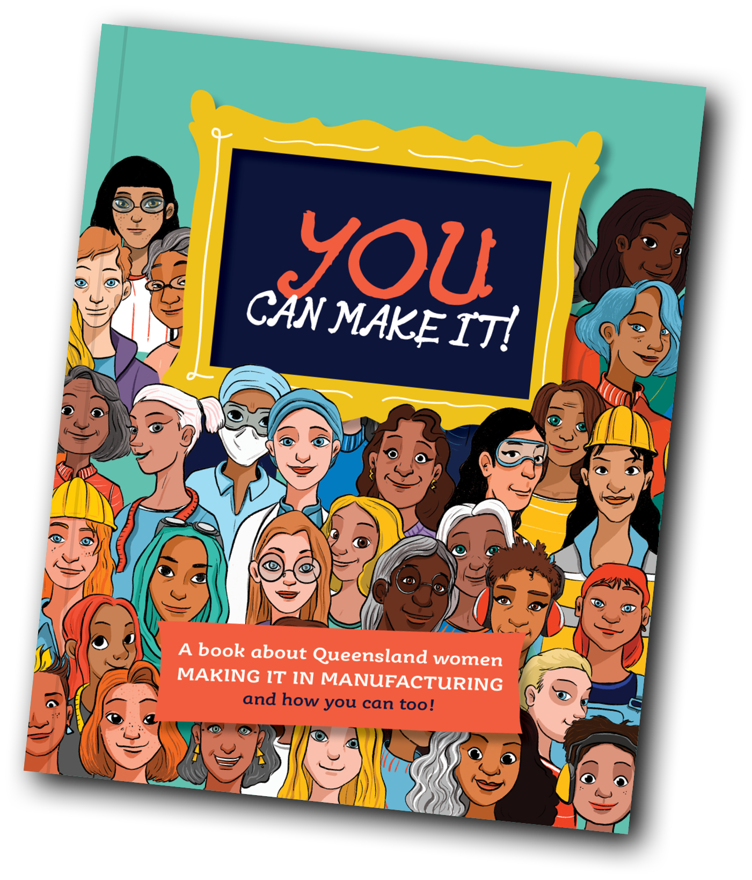
manufacturing
PART ONE:
Discover the world of
GOAL:
I can describe/explain what manufacturing is.
Notes:
Timing:
PART ONE is a one-hour session
Continue to PART TWO for a two-hour session

Slide 3

What
is manufacturing?
Where
does manufacturing
take place?
Who
manufactures?
Notes:
Timing: 7 mins
OPTIONAL ACTIVITY
Materials: A3 paper, post it notes, writing implements, glue, or tape.
Accessing Prior Knowledge
Set up a Y Chart with the following sections – What is manufacturing? Who manufactures? Where does manufacturing happen?
Read the three questions out. Without introducing any further information at this stage, ask students to write their name on each of three post it notes and either write or draw their answer to each, then stick in the appropriate sector of the Y chart.

Slide 4
Self-scoring time!
I can describe/explain what manufacturing is.
1
2
3
4
Notes:
Timing: 3 mins
Goal Statement and Self-Score

Slide 5

Let’s explore!
Turn to Page 2 in your You Can Make It book.
Notes:
Timing: 10 minutes [slides 5-8]
Read the comic together on p. 2-5, then close books.
Discussion Point: What do you think happens next? What might they manufacture? What word could they use that would describe what they are doing instead of ‘manufacture’? [Elicit ‘make’].

Slide 6

Let’s explore!
Turn to Page 6 in your You Can Make It book.
What five manufactured things
can you see around you?
Notes:
Ask students to fill in the Look Around! Brainstorm on p. 6 and compare notes with the person next to them.

Slide 7
Let’s explore!
Turn to Page 31 in your You Can Make It book.
Notes:
Read the end of the comic on p. 31.

Slide 8
Let’s explore!
What would you like to manufacture?
Does it have to be something brand new or could it
be a redesign or improvement on an existing product?
Does it have to be large or can it be something small?
Notes:
Discussion Point:
What would you like to manufacture?
Does it have to be something brand new or could it be a redesign or improvement on an existing product?
Does it have to be large or can it be something small?

Slide 9
Time to apply what we know!
Notes:
Timing: 10 minutes
Choose one activity from Grid 1.

Slide 10


Let’s explore some more!
Bundaberg soft drinks
What are the different parts of this invention that would have to be manufactured?
Where might they have been manufactured?
Notes:
Ask students to think about where the different parts of it might have been manufactured.
Elicit that some are obvious [glass in a factory, for example], whereas others are more subtle [the design for the label on a computer in an office, or the shipment packaging in a warehouse].
Turn to the next slide.

Slide 11


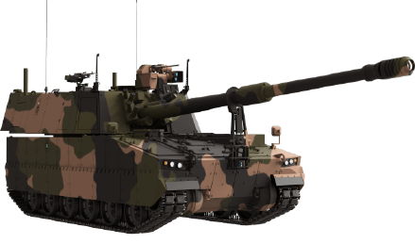


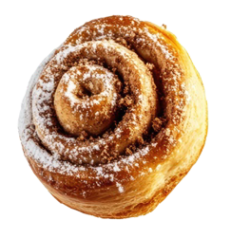
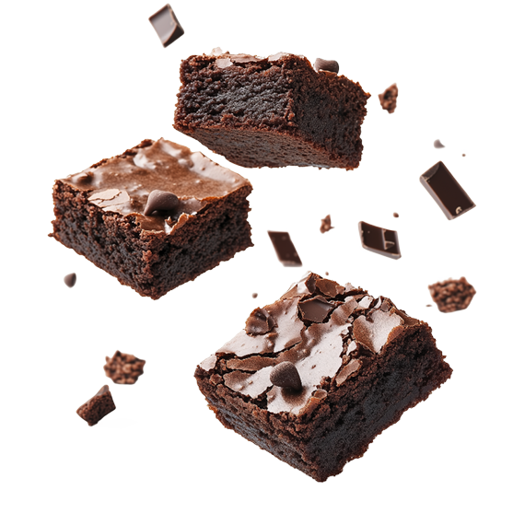

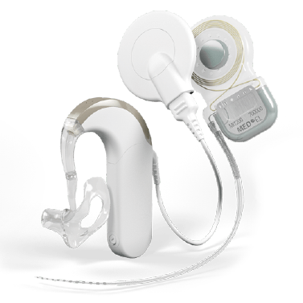
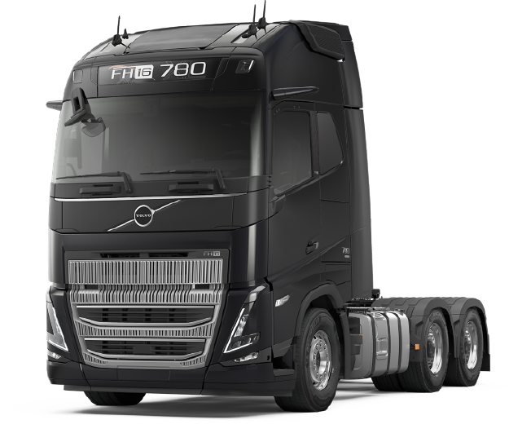

Let’s explore some more!
Military vehicles
Vinyl records
Lick ice cream
Insect repellent
Health products
Volvo trucks
Medical technology
Sweets and treats
Aircraft equipment
Superyachts
Notes:
Ask students to turn to a partner nearby and analyse another of the QLD inventions in the same way.

Slide 12
Time to apply what we know!
Notes:
Timing: 10 mins
Where appropriate for the cohort, choose one activity from Grid 1 to undertake.
This is optional – if time does not allow, move on to the next section.

Slide 13
Self-scoring time!
I can describe/explain what manufacturing is.
1
2
3
4
Notes:
Timing: 2 mins
Restatement of Goal and Self-Scoring (see Introduction)
END OF HOUR 1
**This is the mid-way ‘Exit Point’ if the lesson is held in a one-hour block. If you will be continuing into the second hour of the workshop, this is an ideal opportunity for a brain break**

Slide 14
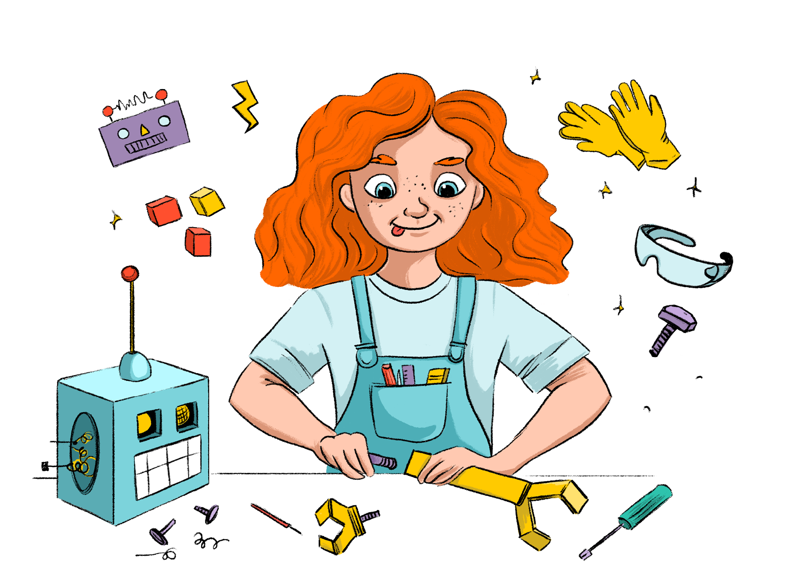
Manufacturing?
PART TWO:
Who is involved in
GOAL:
I can describe/explain who is involved in manufacturing.
Notes:
Timing: Continue with PART TWO for a two-hour session

Slide 15
Self-scoring time!
I can describe/explain who is involved in manufacturing.
1
2
3
4
Notes:
Timing: 5 mins
Goal Statement and Self-Scoring (see Introduction)
State the goal for the second half of the session. Emphasise that the focus is now on the ‘who’ instead of the ‘what’. Ask students to self-score their existing knowledge.

Slide 16
Let’s explore!
I like working in a team best.
I prefer working independently.
I like being given
a plan to follow.
I like writing the
team’s plan.
I like designing and drawing my ideas.
I like using my hands
to bring ideas ‘to life’.
I like ‘going with the flow’ and considering the opinions of others.
I like talking about my opinions and enjoy having them challenged.
I like using processes that I know from experience
will work.
I like researching
new facts and figures to support my plans and ideas.
I like using my imagination
to explore
all the possibilities.
I like to
think practically about how something
will work.
Helpers
Turn to Page 13
Persuaders
Turn to Page 13
Organisers
Turn to Page 27
Thinkers
Turn to Page 23
Creators
Turn to Page 10
Doers
Turn to Page 18
Notes:
Timing: 10 mins [slides 16 to 17]
Anyone can be a Maker (manufacturer)! Put the flow chart up and ask students to answer the questions in their mind and follow the flow chart until they get to the bottom and an assigned member of the Maker Squad.
Have pieces of A4 paper at the front of the classroom with one labelled for each of the Maker Squad. Students could either write their names on the piece of paper of the member they matched with from the flow chart, or put their name on a post it note and stick it to the corresponding paper.

Slide 17

Let’s explore!
Would you have predicted which
Maker Squad member the quiz thinks
you are most like?
Do you agree or disagree with the result?
What do you think each Maker Squad member might think is their greatest strength/weakness?
Notes:
Discussion Points:
Would you have predicted which Maker Squad member the quiz thinks you are most like?
Do you agree or disagree with the result?
What do you think each Maker Squad member might think is their greatest strength/weakness?

Slide 18
Time to apply what we know!
Notes:
Timing: 15 mins
Application
Choose one activity from Grid 2.

Slide 19

Let’s explore some more!
Turn to Page 11 in your You Can Make It! book.
Notes:
Timing: 15 mins [slides 18 and 19]
Read Simone Wilson’s profile on p.11.
On one side of the board, draw the plane she is working on. Ask who else would be in this manufacturing squad? Draw the obvious ones involved in the process as they are brought up [for example, welder, spray painter, etc.] and then ask questions about the little details and who might be responsible for those [fitter machinist/packer, zero harm/safety/first aid officer, etc.] – encourage them to reference the book where appropriate for their level.

Slide 20
Let’s explore some more!
Vinyl records
Military vehicles
Lick ice cream
Insect repellent
Bundaberg soft drinks
Health products
Volvo trucks
Medical technology
Sweets and treats
Aircraft equipment
Superyachts
Notes:
Remind them of the ‘where’ they established in the process of manufacturing.
Now ask them ‘who’ is involved at each stage.
Can be done as a think/pair/share, either on paper or verbal.
Discussion Point:
Manufacturing is not an occupation of isolation – people are interconnected in lots of different ways.
Which would you think might be the occupations that interact with each other most often? Why?

Slide 21
Time to apply what we know!
Notes:
Timing: 10 mins
Application
Choose one activity from Grid 2.
This is optional – if time does not allow, move on to the next section.

Slide 22
Self-scoring time!
I can describe/explain who is involved in manufacturing.
1
2
3
4
Notes:
Timing: 5 mins
Goal Reiteration and Self-Scoring (see Introduction).

Slide 23

There’s so much more to learn!
Take your book home and read it with your family and friends!
Notes:
You may like to suggest students take the You Can Make It! book home, and as a home learning task ask if anyone the family knows has a job in manufacturing.
They may like to annotate the Maker Squad pages with the name and job title of people who are brought up in the conversation, and collate it in the classroom as a follow-up.
END OF HOUR 2

